Slide 1

Sub-Team 2

Slide 2

Building Models
🔍 Modeling Approaches
To understand the problem from different perspectives, we applied both classical machine learning and deep learning models to predict hourly traffic volume:
✅ Classical ML Approach:
XGBoost Regressor:
A powerful tree model known for its high performance
in predictive problems.
His ability to interpret results through feature importance.
Fast to train and easy to interpret.
✅ Deep Learning Approach:
LSTM / GRU Networks:
Designed to capture time-series dependencies.
Can learn patterns from sequences of past hours.
Better suited for modeling trends over time.
🎯 Purpose of Using Both:
To compare different modeling techniques on the same problem.
To find whether the traffic volume is better explained by static feature relationships (XGBoost) or time-sequential patterns (LSTM / GRU).

Slide 3
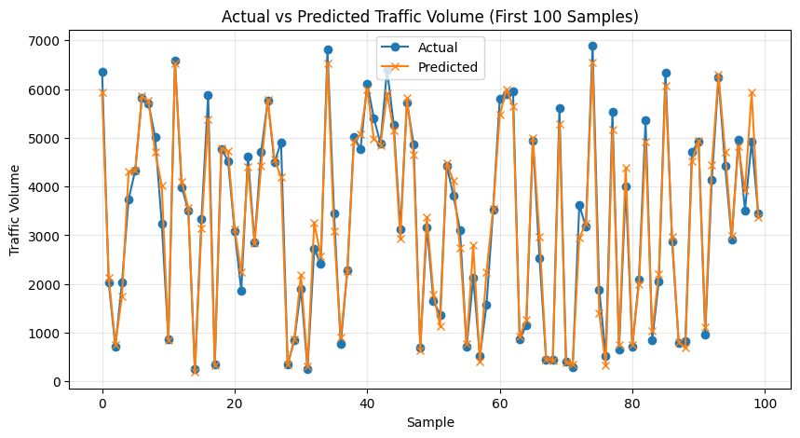
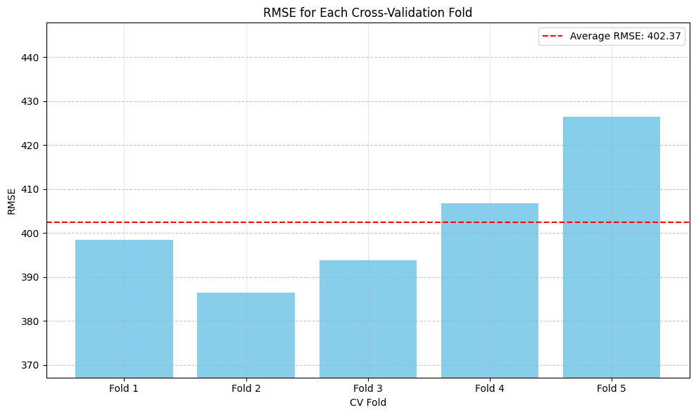
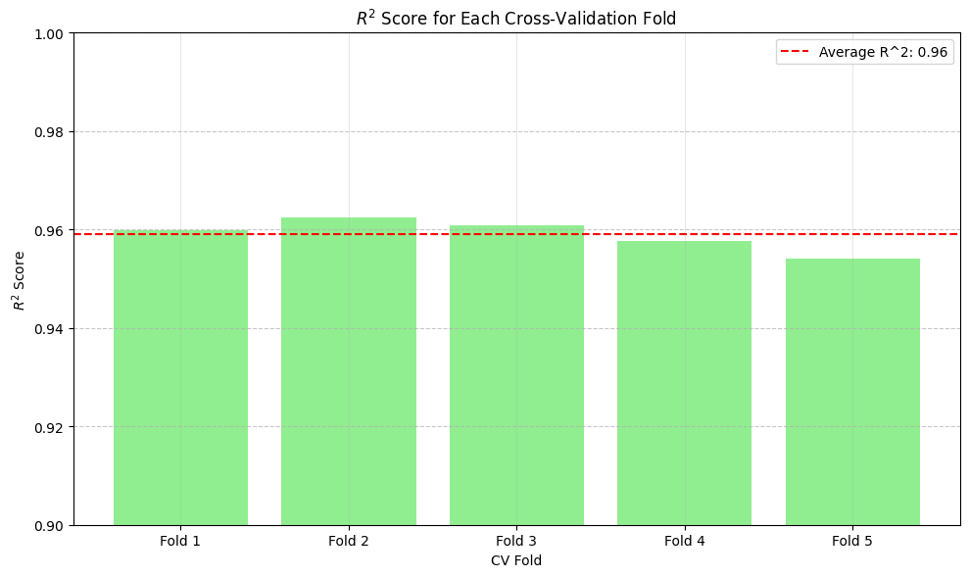
XGBoost Regressor:
Train a Classical ML Model (XGBoost)
Define Features and Target
Split the Dataset
Train the XGBoost Regressor
R² Score : 0.96
The model successfully explained 96% of the variance in traffic volume, an indication of excellent accuracy.
🔍Cross-Validation for Model
5 - Fold Cross-Validation
Used 5-fold K-Fold Cross-Validation with shuffling to ensure better randomness.
Calculated:
Root Mean Squared Error (RMSE)
R² Score

Slide 4
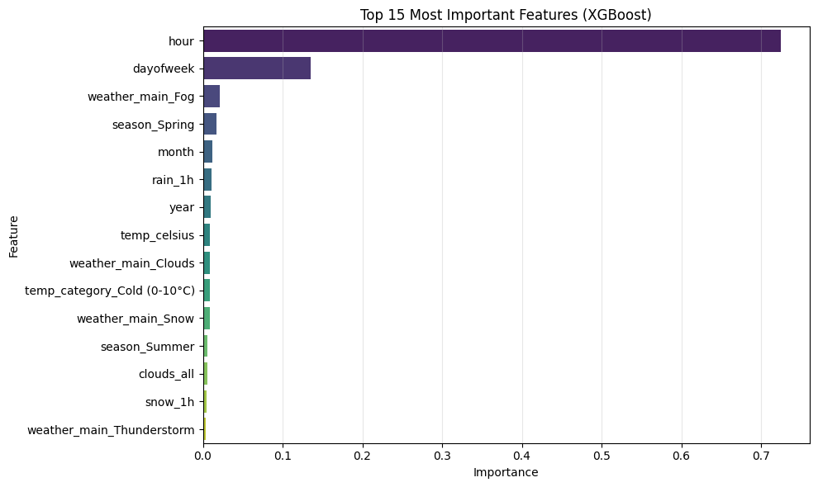
XGBoost Regressor:
🔑 Key Influencing Factors (according to the model):
Hour: The most influential factor, underscoring the importance of peak times.
Day of Week: Clearly distinguishes between workdays and weekends.
Weather: Has a significant influence, especially severe weather conditions.
Month: Reflects strong seasonal patterns.
Conclusion from this model:
Traffic volume can be effectively forecasted by understanding a combination of temporal and environmental factors.

Slide 5





LSTM Model Data Preparation Flow
Select Features
Choose important columns including time-based features, weather/season indicators, continuous weather data, and target variable.
Convert Dummies
Transform dummy variables into integer format for model compatibility.
Train/Test Split
Split data by time: training set ≤ 2017, testing set > 2017 to prevent data leakage.
Feature Scaling
Apply Min Max Scaler fitted on training data; normalize all data between 0 and 1.
Create Sequences
Use sliding window of 3 previous hours as input (X) to predict current hour traffic volume (y).

Slide 6
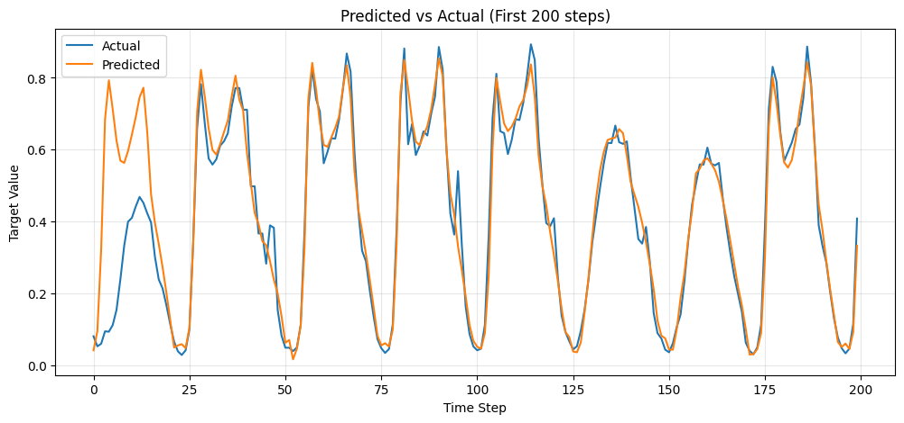
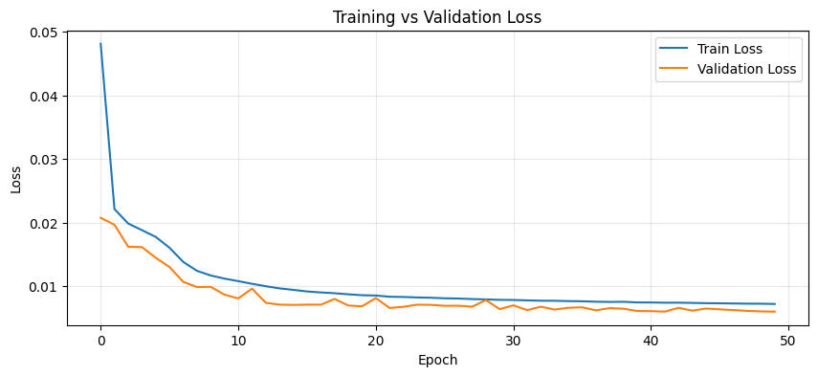
LSTM Model (Next 1 Hour)
🔧 Build and Train LSTM Model
🏗️ 1 Model Architecture
LSTM Layer 1: 50 units, returns sequences for the next LSTM layer.
LSTM Layer 2: 50 units, outputs a single vector.
Dense Layer: Outputs the predicted traffic volume.
Loss Function: Mean Squared Error (mean squared error).
Optimizer: RMSprop (efficient for RNNs like LSTM).
🛡️ 2 Regularization and Stability
Commented out Dropout layers to avoid underfitting initially.
Used Early Stopping:
Monitors validation loss.
Stops training if there's no improvement for 8 consecutive epochs.
Restores the best model weights found during training.
3 ⚙️Model Training
Epochs: up to 100 (stops early if overfitting detected).
Batch Size: 32 (a standard size for balancing performance and stability).
Verbose: set to 0 for silent training.
🔮 4 Predictions and Evaluation
MAE (Mean Absolute Error): 0.048
RMSE (Root Mean Squared Error): 0.077
R² Score: 0.918

Slide 7
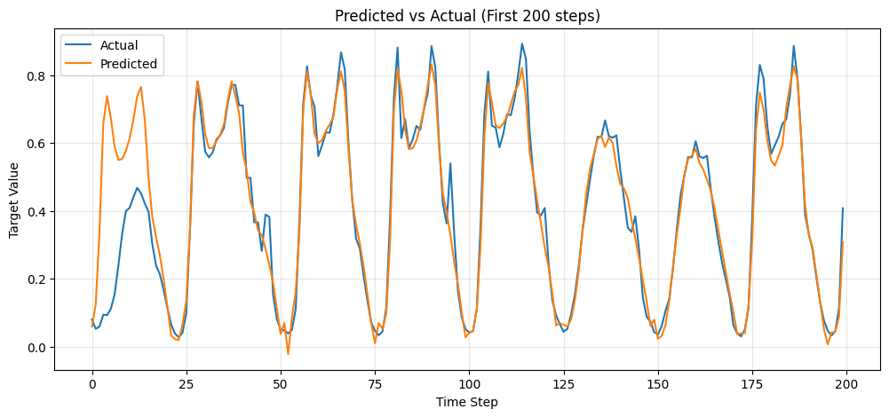
GRU Model (Next 1 Hour)
🔧 Build and Train GRU Model
🏗️ 1 Model Architecture
GRU Layer 1: 50 units, returns sequences for the next GRU layer.
GRU Layer 2: 50 units, outputs a single vector.
Dense Layer: Outputs the predicted traffic volume.
Loss Function: Mean Squared Error (mean_squared_error).
Optimizer: Adam optimizer with a learning rate of 0.0005 (faster convergence compared to RMSprop).
🛡️ 2 Regularization and Stability
Commented out Dropout layers to test model capacity without regularization first.
Used EarlyStopping:
Monitors validation loss (val_loss).
Stops training if there's no improvement for 8 consecutive epochs.
Restores the best model weights found during training.
⚙️ 3 Model Training
Epochs: Up to 100 (early stopping will stop before if overfitting occurs).
Batch Size: 32.
Verbose: set to 0 for silent training (change to 1 for detailed output).
🔮 4 Predictions and Evaluation
MAE (Mean Absolute Error): 0.050
RMSE (Root Mean Squared Error): 0.078
R² Score: 0.917

Slide 8
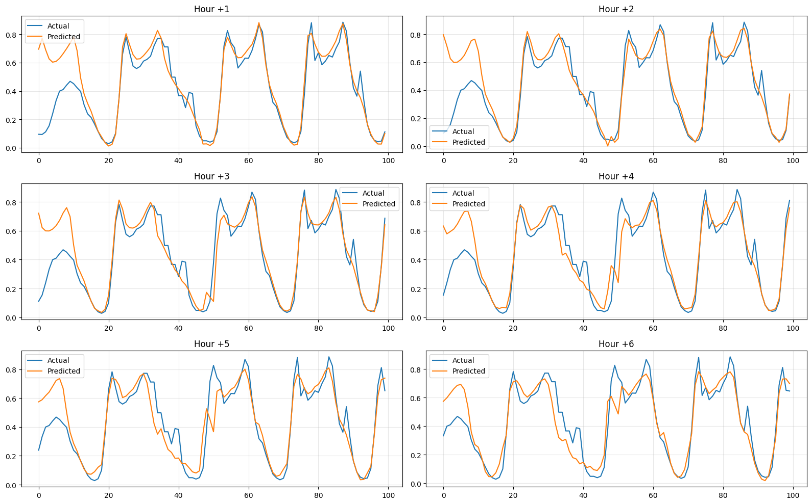
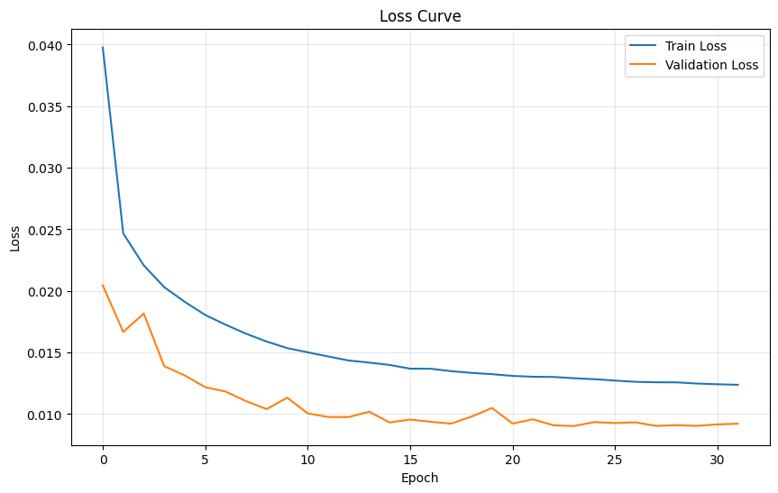
LSTM Model (Next 6 Hours)
🔧 Build and Train LSTM Model for Multi-Step Forecasting
🏗️ 1 Model Architecture
LSTM Layer 1: 32 units, returns sequences.
Dropout Layer: 20% dropout to reduce overfitting.
LSTM Layer 2: 32 units, outputs the final hidden state.
Dense Layer: Outputs 6 values, each predicting the traffic volume for
the next 6 hours.
Loss Function: Mean Squared Error (mse).
Optimizer: Adam.
🛡️ 2 Regularization and Stability
Used Dropout to avoid overfitting.
Added EarlyStopping:
Monitors validation loss (val_loss).
Stops training if no improvement occurs for 8 consecutive epochs.
Restores the best weights.
3 ⚙️ Model Training
Epochs: Up to 50 (can stop early).
Batch Size: 32.
Verbose: set to 0 for silent training.
🔮 4 Predictions and Evaluation
Model predicts a sequence of 6 traffic volumes for each test sample.
MAE (Mean Absolute Error): 0.061
RMSE (Root Mean Squared Error): 0.095
R² Score: 0.877

Slide 9
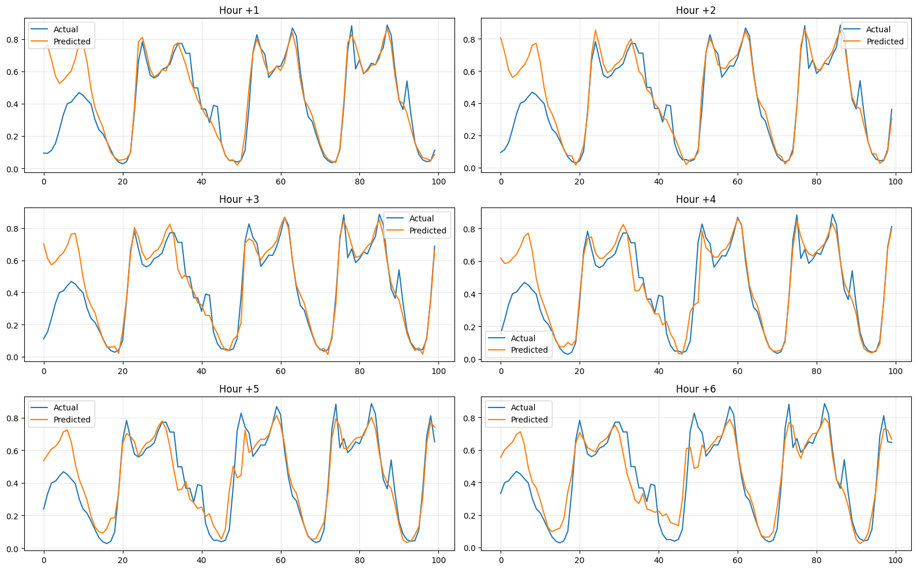
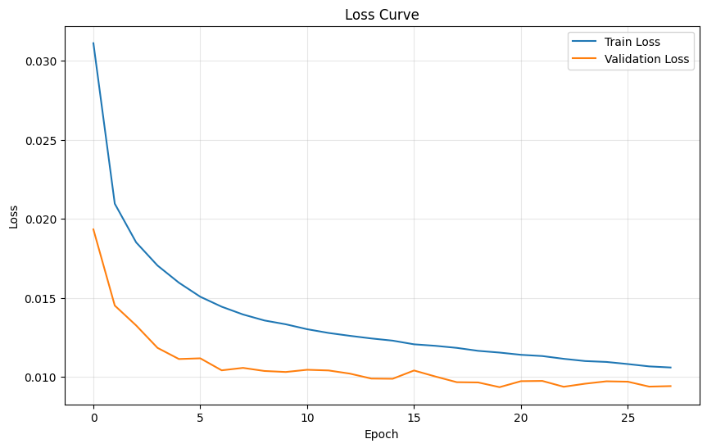
GRU Model (Next 6 Hours)
🔧 Build and Train GRU Model for Multi-Step
Forecasting
🏗️ 1 Model Architecture
GRU Layer 1: 64 units, returns sequences.
GRU Layer 2: 64 units, outputs the final hidden state.
Dense Layer: Outputs 6 values, predicting the next 6 hours.
Loss Function: Mean Squared Error (mse).
Optimizer: Adam.
🛡️ 2 Stability & Regularization
Dropout layers were removed in this version for testing.
Used Early Stopping same as before.
3 ⚙️ Model Training
Epochs: Up to 50 (early stopping applies).
Batch Size: 32.
Verbose: Silent training (verbose=0).
🔮 4 Predictions and Evaluation
Predicted 6 traffic volume values for each input.
MAE: 0.062
RMSE: 0.097
R²:0.873

Slide 10
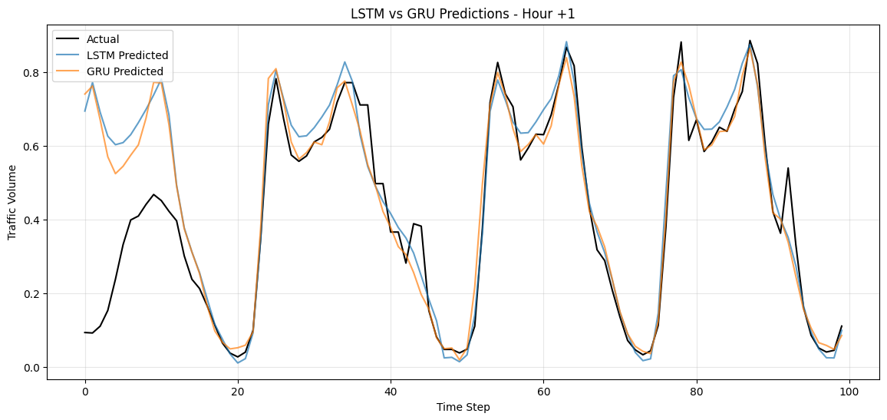
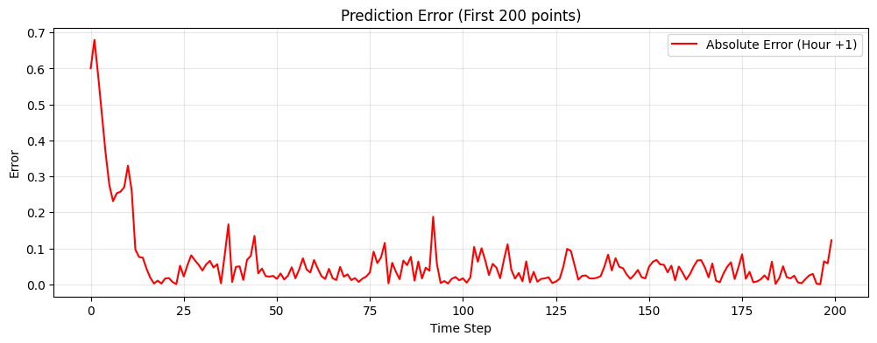
Summary
✅ Key Insights
Both models can capture hourly traffic patterns, but GRU showed better generalization.
LSTM required more regularization (early stopping, dropout) to avoid overfitting.
GRU trained faster and gave slightly better RMSE on test data.
✅ Summary of Results
We applied both LSTM and GRU models to predict traffic volume over the next 6 hours using hourly and weather-related data.
The models were evaluated using MAE, RMSE, and R² Score.
🔢 Performance Results
🔍 Key Takeaways
Both LSTM and GRU gave very close performance, with LSTM performing slightly better on the test data.
No significant overfitting was observed in either model.
The models successfully captured the hourly traffic patterns and provided accurate multi-step predictions.
Either model could be used for time-based forecasting, but LSTM had a slight performance edge in this case.
GRU Model | LSTM Model | Metric
0.063 | 0.060 | Test MAE
0.096 | 0.093 | Test RMSE
0.874 | 0.881 | Test R²
No clear overfitting | No clear overfitting | Overfitting

